Slide 1
A Thesis Proposal Defense on Photographic Text-to-Image Synthesis via Multi-turn Dialogue using Attentional GAN
SHIVA KUMAR SHRESTHA
ME Computer(MECE)
(15957)

Slide 2
Outline
Introduction
Problem Statement
Motivation
Thesis Objective
Literature Review
Methodology
Datasets
Expected Outcome
Gantt Chart
Conclusion
References

Slide 3
Introduction

Slide 4
Problem Statement

Slide 5
Motivation

Slide 6
Thesis Objective
To generate photo-realistic image from given text description via multi-turn dialog using Attentional GAN

Slide 7
Literature Review
Generative Adversarial Nets for Text-to-Image Synthesis
Image Generation and Editing
Image-to-Image Synthesis
Realistic Image Synthesis with Stacked Generative Adversarial Networks
Hierarchically-nested Adverserial Network for High-Quality Image Generation
Story Visualization
Conditional GANs

Slide 8
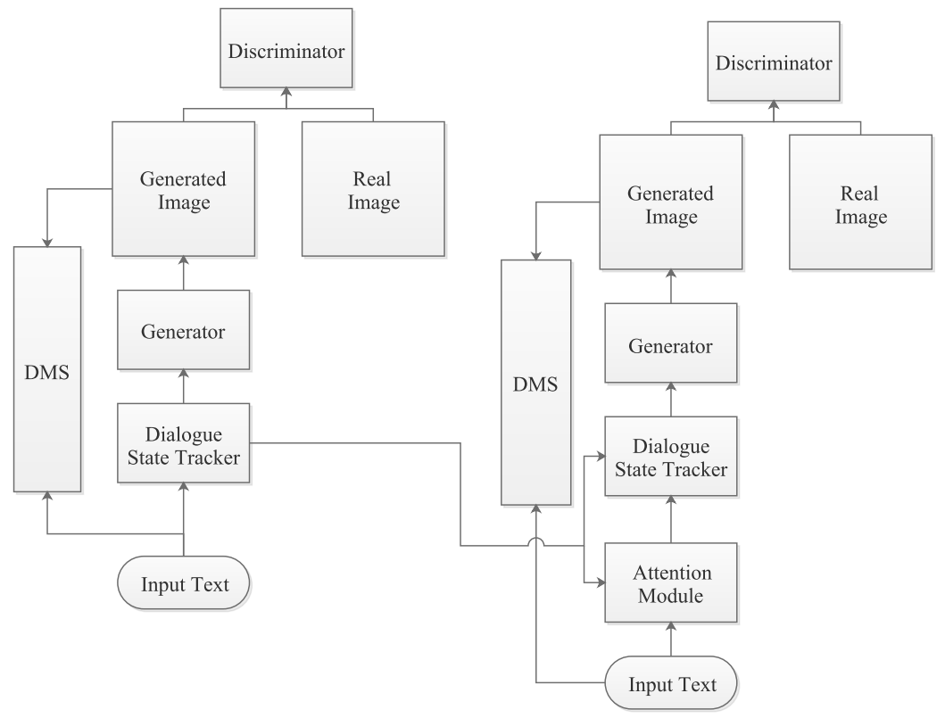
Methodology
Abc

Slide 9
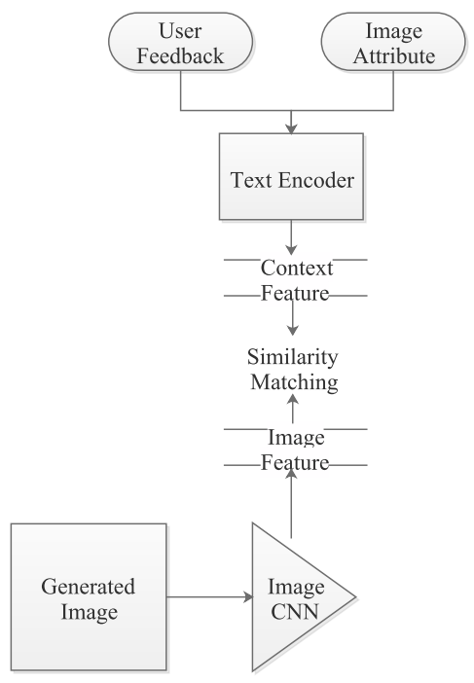
Methodology (Cont…)
Abc

Slide 10
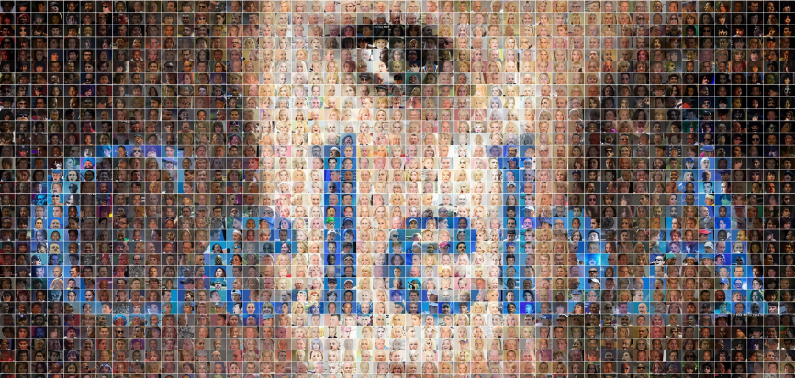
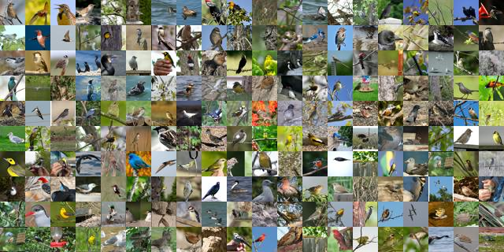
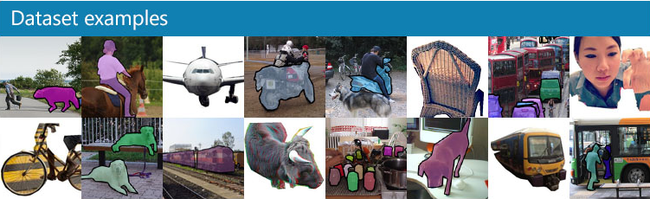
Datasets
CelebA
CUB 200
MS COCO

Slide 11
Expected Outcome
Photo-realistic image will be generated during conversational phases
This work will be tested using three datasets:
CelebA,
CUB 200 and
MS COCO

Slide 12
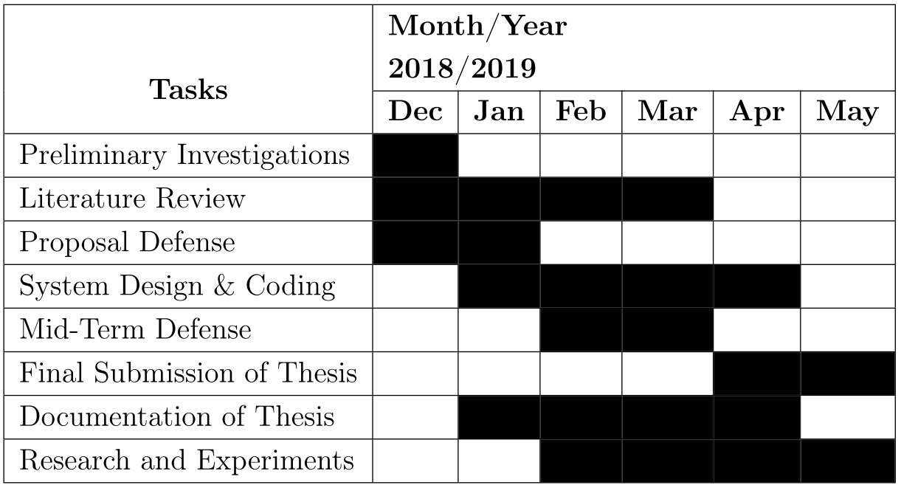
Gantt Chart

Slide 13
Conclusion

Slide 14
References
[1] Xu, T., Zhang, P., Huang, Q., Zhang, H., Gan, Z., Huang, X., and He, X. (2018). Attngan: Fine-grained text to image generation with attentional generative adversarial networks. CoRR, abs/1711.10485, 2017.
[2] Chen, Q., Koltun, V. (2017, October). Photographic image synthesis with cascaded reﬁne-ment networks. In IEEE International Conference on Computer Vision (ICCV) (Vol. 1, No.2, p. 3).
[3] Zhang, H., Xu, T., Li, H., Zhang, S., Wang, X., Huang, X., and Metaxas, D. N. (2017) Stackgan++: Realistic image synthesis with stacked generative adversarial networks. arXiv: 1710.10916, 2017.
[4] Karras, T., Aila, T., Laine, S. and Lehtinen, J. (2018) Progressive growing of gans for improved quality, stability, and variation. In ICLR, 2018. 2, 3, 11
[5] Dong, H., Yu, S., Wu, C., Guo, Y. (2017). Semantic image synthesis via adversarial learning. arXiv preprint arXiv:1707.06873.
[6] Zhang, H., Xu, T., Li, H., Zhang, S., Wang, X., Huang, X., and Metaxas, D. N. (2017) Stackgan: Text to photo-realistic image synthesis with stacked generative adversarial networks, ICCV
[7] Zhu, J. Y., Park, T., Isola, P., Efros, A. A. (2017). Unpaired image-to-image translation using cycle-consistent adversarial networks. arXiv preprint.

Slide 15
Q/A?
Thank You!
Shiva Kumar Shrestha
shrestha.shiva@hotmail.com

